Slide 1
MyKoko Sales App Improvements
Q4 2019

Slide 2
Pain points
Current Experience
Proposed New Experience
Scope Summary
Current Screens
Proposed Designs
Requirements & User Stories
Questions & Assumptions
Next Steps
Updated Scope

Slide 3

MyKoko App - Pain Points
The MyKoko app is used to sign up new customers, track the progress of existing customers and plays a key role in the sales teams’ day-to-day activities. It therefore plays a crucial role in how quickly the CSRs can grow our customer base, ensure fulfillment of the cookers and follow up with potential customers.
Sales reps find it difficult to track their different sales leads with the myKoko app, because of the structure of their sales lists within the app. For example:
The customer list has the oldest customer at the top and the newest customer at the bottom of the list. This forces users to scroll to the very bottom of the list to find their most recent customers information.
The customer list is not segmented into the types of customers they have within their sales pipeline. This makes it difficult for them to focus on a particular category when following up.
MyKoko also has lots of areas that could be tweaked to improve the overall experience for users, both customers and sales reps. For example, navigation, a few UI tweaks, clearer copy, etc.

Slide 4
Current Experience
Logs Into Account
Opens Customer List
Manually Scrolls to the Bottom
Makes Follow Up Call
Manually Searches for the right Customer Type to follow up with.

Slide 5
New Experience - Options
Option A - Quick Win
Option B - Longer Term (more complex)
User Logs In
CSR Receives Notification
Opens Customer
Lists
Easily views their customer’s activity
Information
about customer
needing follow up
Calls Customer
Calls customer for follow up

Slide 6
Summary of Scope
Overview of the changes proposed are the following:
Scope areas | Changes/Details
Customer Segmentation List | Reverse the order of customers (most recently active at the top of the list) Separate the types of customers into specific lists Organize customers based on recency in activity in their account Include the number of customers in each segment Update the lists in real-time based on customer activity
Navigation | Add ‘My Account’ to the bottom navigation bar Include more links on the Home Page
Session Length | Increase session length from 5 seconds to 15 seconds
UI Updates | Home page and Make Money Page UI updates
Copy Changes | Make relevant information clearer

Slide 7
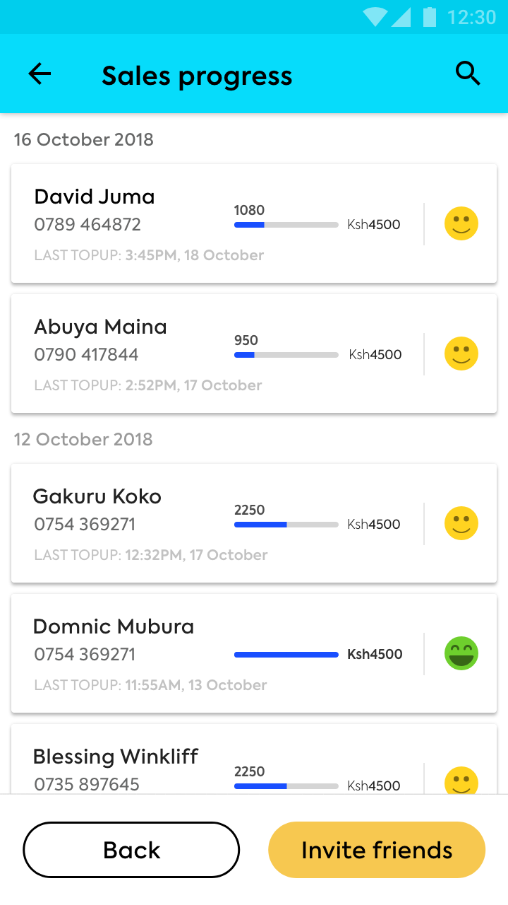
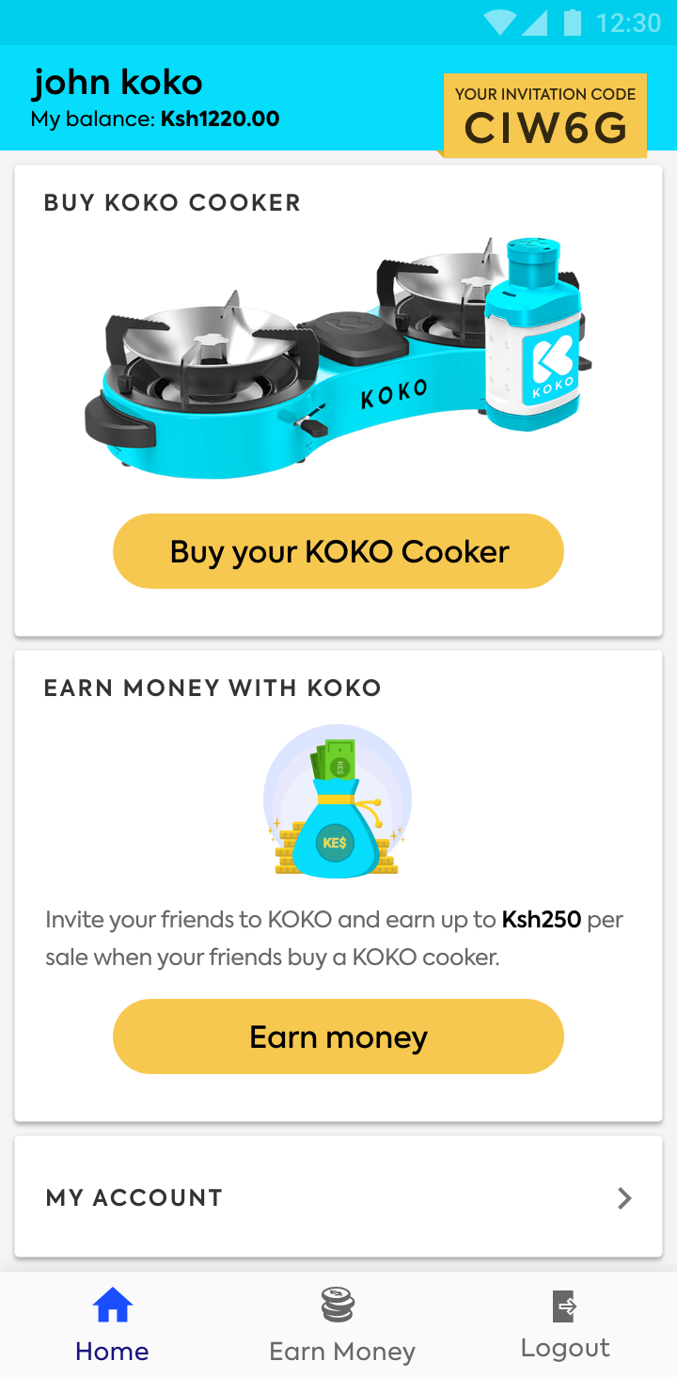
Current Screens
Customer Sales List
Home Screen

Slide 8
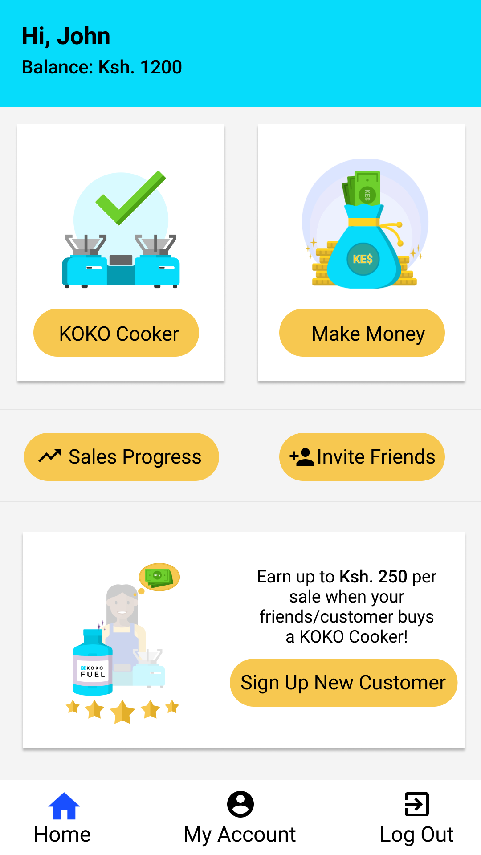
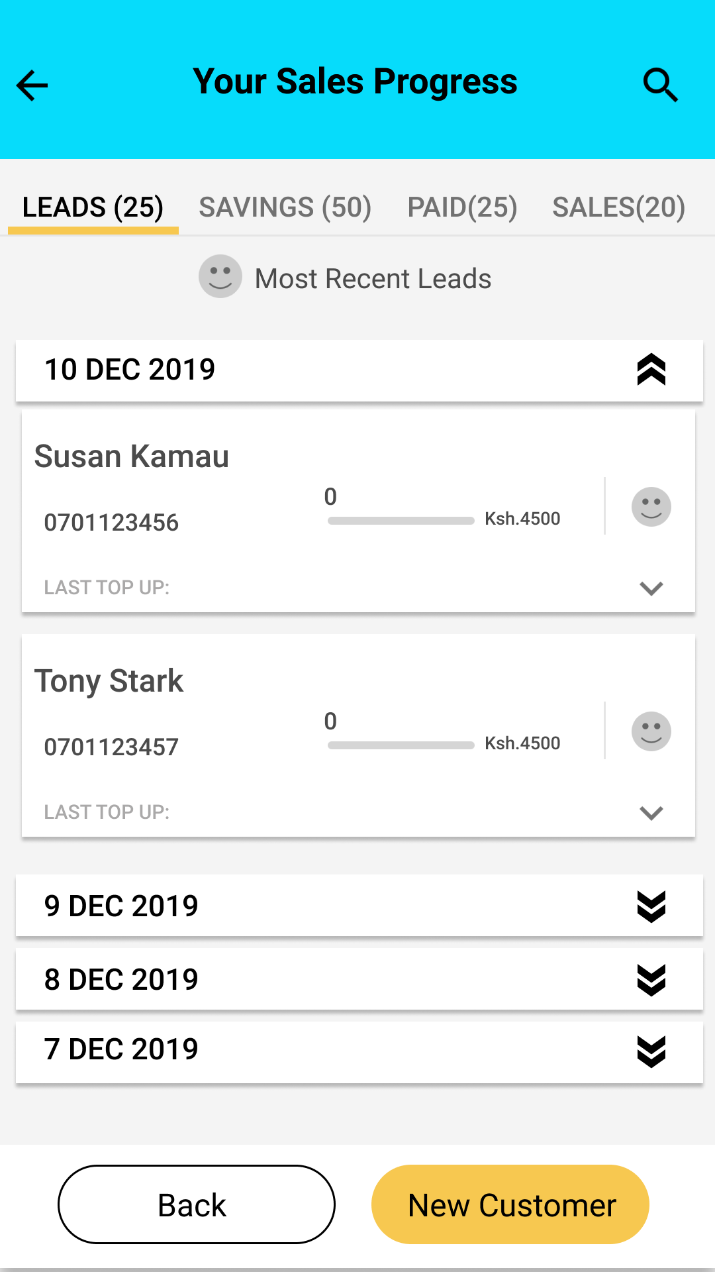
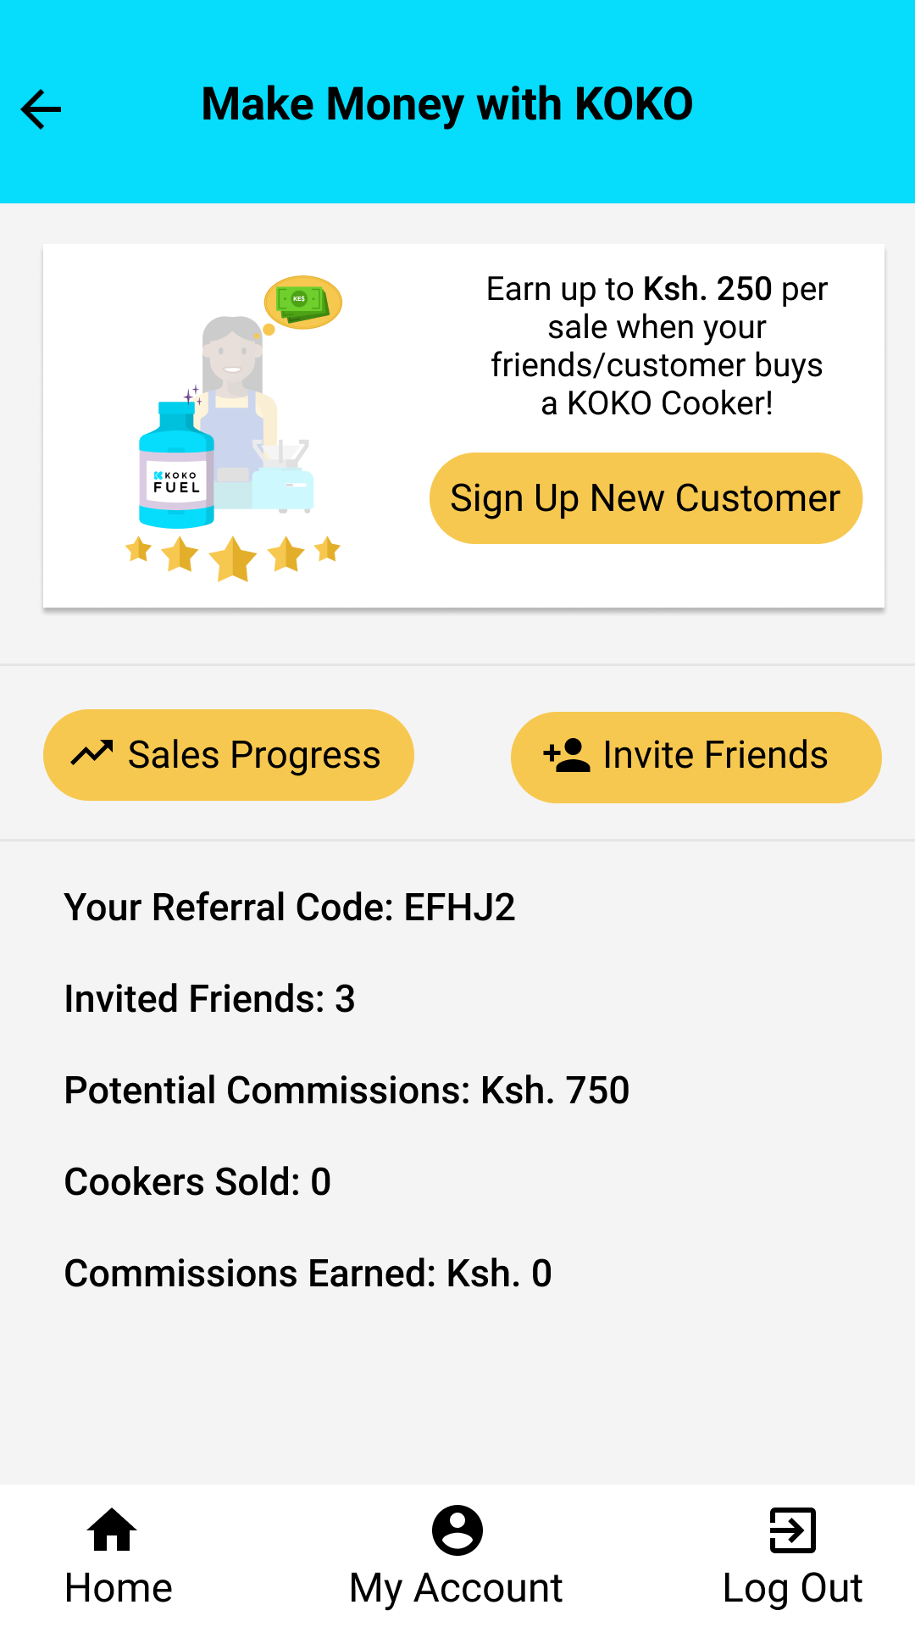
Proposed Designs
Link to all Designs: Designs 2
Home Screen (centralised)
Customer Lists (segmented)
Make Money Screen (UI updates)
Notes:
Final designs pending

Slide 9
Requirements & Stories
User Stories | Fixes
As a user, I want to know where my customers are within the pipeline, so that I can decide when to follow up with them. | Increase session length for users to have more time before being logged out of their account
As a user, I want to find important pages easily, so that I can get more done faster. | Change copy on certain pages of the app
As a user, I want to manage my customer list, so that I can get a clearer sense of where a customer is within the pipeline. | General UI changes on certain pages of the app
As a user, I want to contact KOKO, so that I can get help with an issue.
As a user, I want to search for a specific customer/number, so that I can find information about the customer/number
Details of requirements and user stories on this google sheet

Slide 10
Questions & Assumptions
How ‘warm’ should the sales pipeline be? How far back (dates) should the sales pipelines go? At what point do we archive potential customers?
Should we add a ‘Leads’ segment? The ones that are being manually written down by CSRs?
How will this affect the ‘search’ functionality? Should the search apply to the selected list?
Can we revisit analytics on the app for better tracking?

Slide 11
Next steps
Clarify open questions and potential journeys - done
Discuss priority of different scope elements - done
Prepare final designs - pending
Plan resourcing with Engineering Team - pending

Slide 12
Updated scope
17th Dec
De-prioritise changes to the ‘Make Money’ Page since the main area for change is the customer sales lists

Slide 13
For more information, contact:
Nyawira Njoroge
n.njoroge@kokonetworks.com

